Slide 1
MSA 8600 Deep Learning Final Project Spring 2023
Anesia McCarthy
Jibi Jacob
Shreyashi Mukhopadhyay
Swathy Raja

Slide 2
Microsoft Stock Price Prediction using Recurrent Neural Networks
Shreyashi Mukhopadhyay
Anesia McCarthy

Slide 3



Introduction: Stock Price Prediction Using RNN
The stock market has enormously large historical data that varies with trade date, which is time-series data.
LSTM and GRU models within RNN based models are widely used for sequence prediction problems and have proven to be extremely effective as they can store past important information and forget the information that is not.
In this project we have applied simple and composite RNN models like LSTM, CNN-LSTM, BiLSTM, CNN-BiLSTM & GRU in conjunction with NEURAL Prophet to predict the closing price of the stock.

Slide 4


About Microsoft
Microsoft was listed on NASDAQ on March 13, 1986, at an opening price of $21 per share.
Microsoft is the world’s largest software maker.
Best known for its software products, including Microsoft Windows Office Suite, Bing search engine, Skype and the Internet Explorer web browser.
Microsoft has revolutionized the gaming space with its the Xbox series of video game consoles.

Slide 5
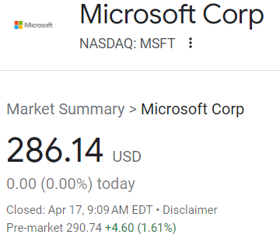
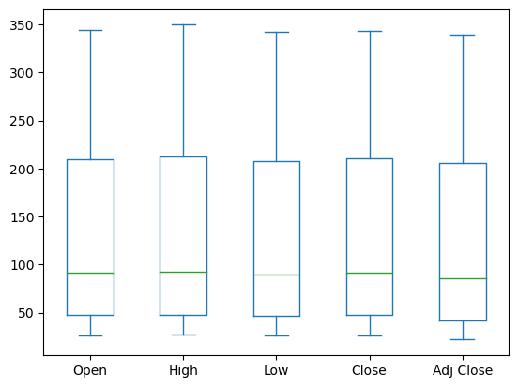
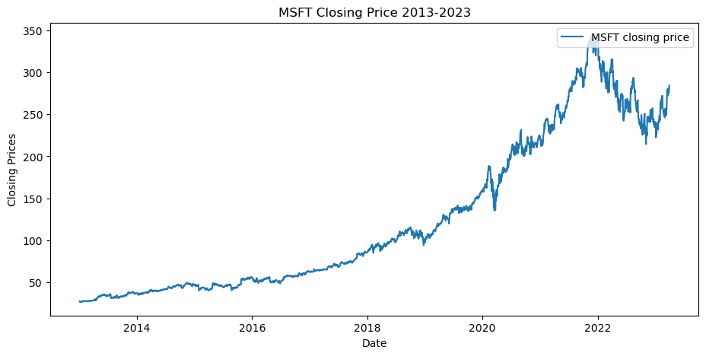

Microsoft Stock Price History (2013-2023)
Data Source:

Slide 6
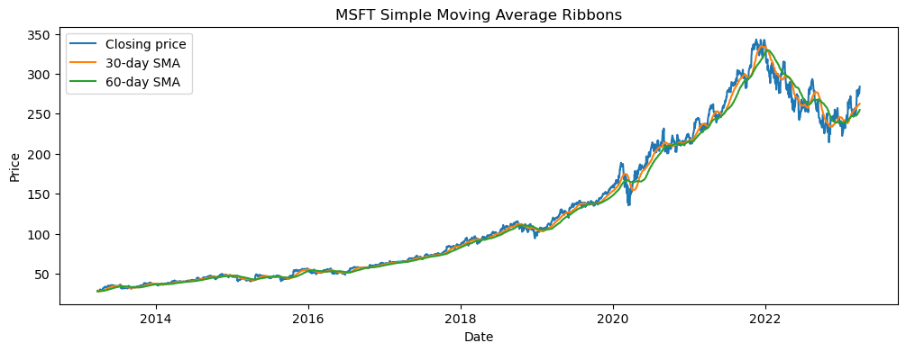
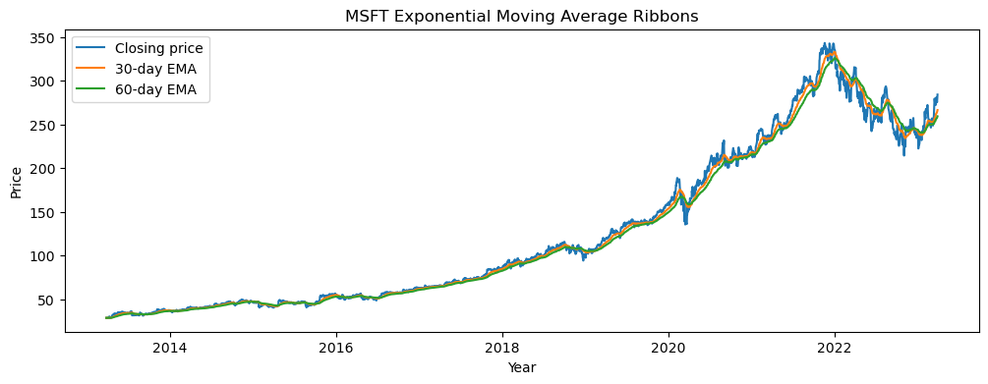
Microsoft Trend Indicators
30 Day & 60 Day Simple Moving Averages
30 MA crossing over 60 MA shows Bullish Trend
60 MA crossing over 30 MA shows Bearish Trend
30 Day & 60 Day Exponential Moving Averages

Slide 7
Models Used
Neural Prophet
CNN LSTM
LSTM
CNN Bi LSTM
Bi LSTM
GRU

Slide 8
Neural Prophet
Developed by Facebook
Processes large amounts of data very quickly
Handles Outliers
Handles Missing Values
y(t) = g(t) + s(t) + h(t) + e(t)
g(t) representing the trend. Prophet uses a piecewise linear model for trend forecasting.
s(t) represents periodic changes (weekly, monthly, yearly).
h(t) represents the effects of holidays (recall: Holidays impact businesses).
e(t) is the error term.

Slide 9
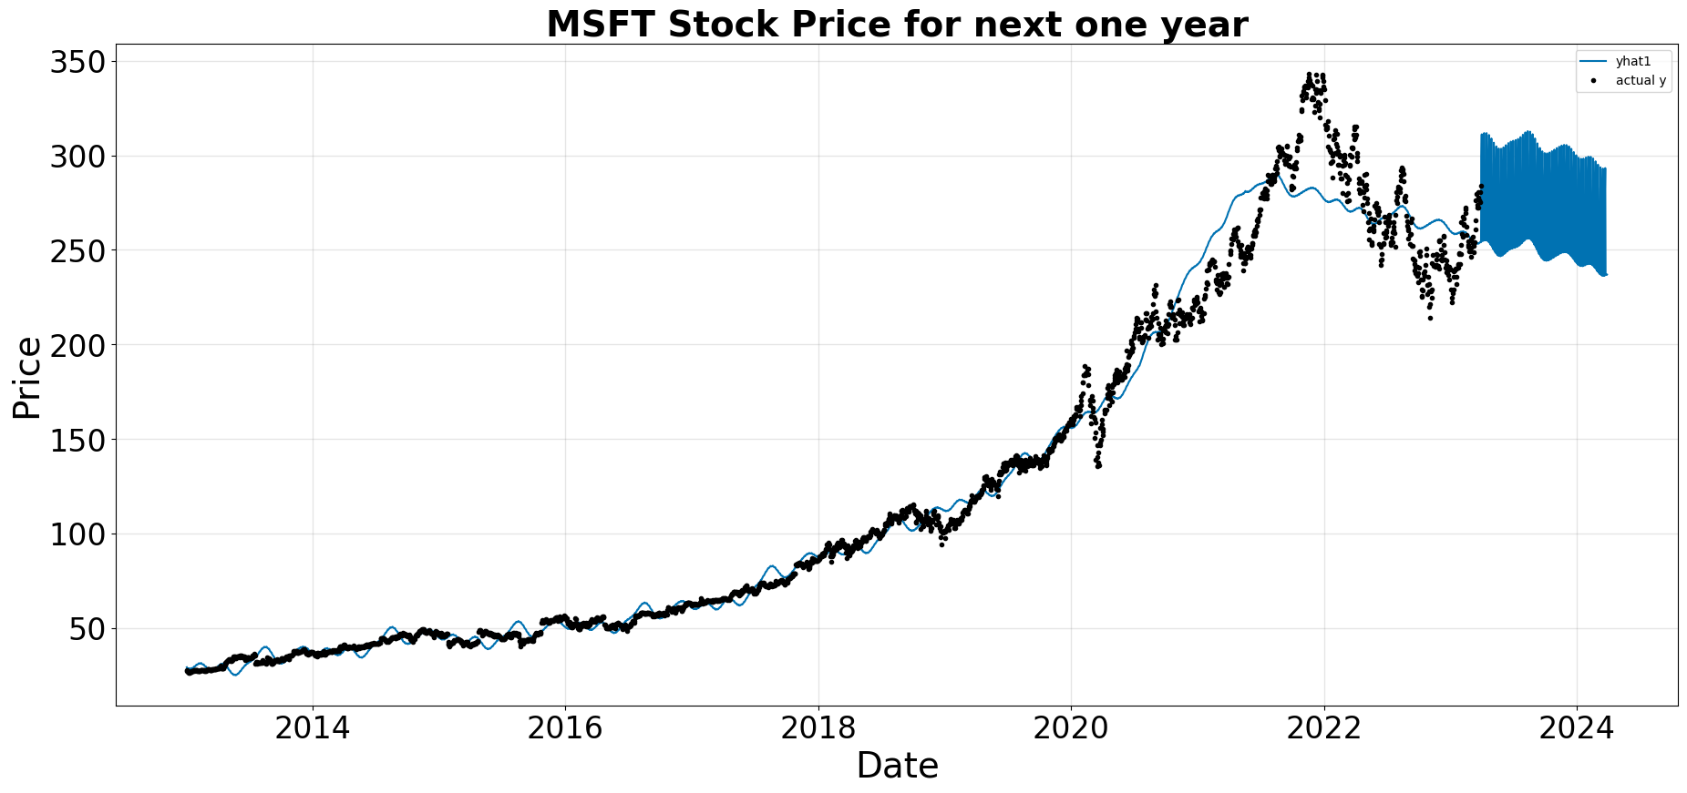
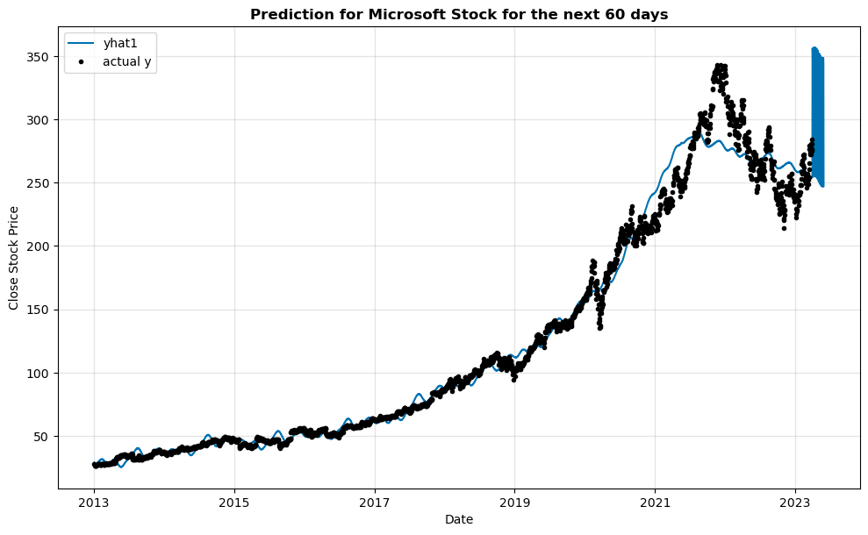
Neural Prophet
 | SmoothL1Loss | MAE | RMSE | RegLoss
146 | 0.001211 | 8.153888 | 12.904163 | 0.0

Slide 10
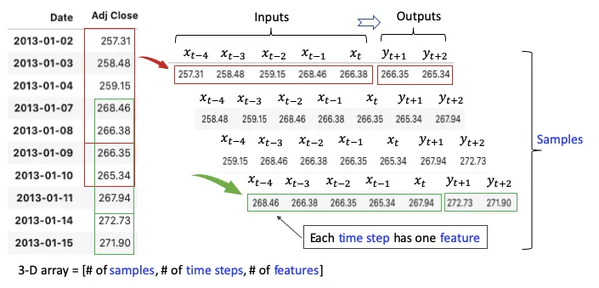
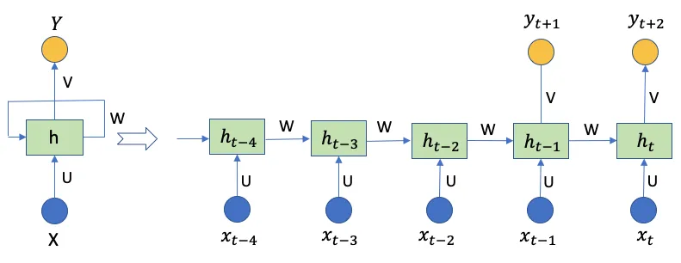
LSTM Architecture for Stock price prediction
Many - Many relationship
The three dimensions are:
Tensor: One tensor is a vector that enters the model
Time Step: One-time step is one observation in the tensor.
Feature: One feature is one observation at a time step.

Slide 11
Data Preprocessing
Original Data
Date | Open | High | Low | Close | Adj Close | Volume
1/2/2013 | 27.25 | 27.73 | 27.15 | 27.62 | 22.71778 | 52899300
1/3/2013 | 27.63 | 27.65 | 27.16 | 27.25 | 22.41346 | 48294400
1/4/2013 | 27.27 | 27.34 | 26.73 | 26.74 | 21.99397 | 52521100
Filter on Close price
Data length : 2579
Train Test Split: 80:20
Train data length : 2063
Validation data length : 516
Min-max Scaler ⇒ (0,1)
Time steps =60
Date | Close
1/2/2013 | 27.62
1/3/2013 | 27.25
1/4/2013 | 26.74
Final Data Dimensions
x_train.shape = (2004, 60, 1)
y_train.shape = (2004,)
x_test.shape = (515, 60, 1)
y_test.shape = (515, 1)
Convert data from a 2D array to 3D array

Slide 12
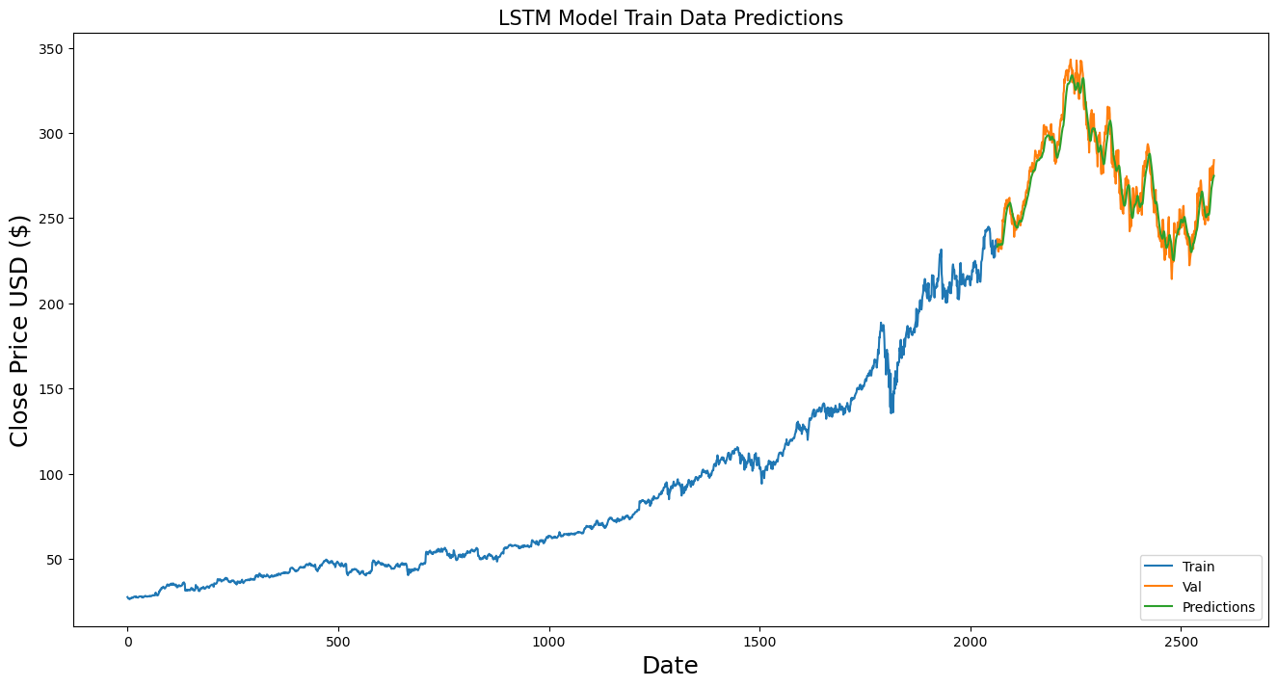
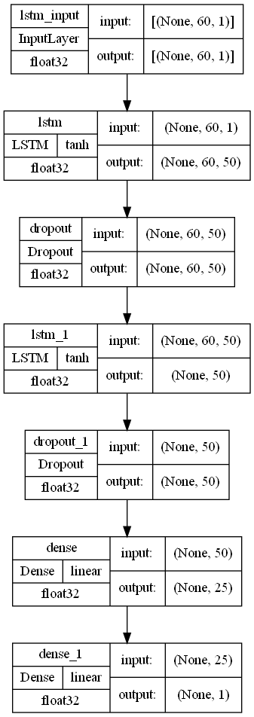
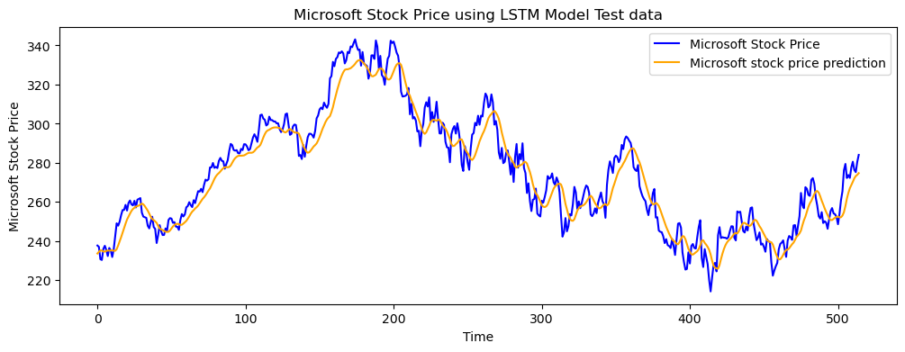
LSTM Model
R^2 = 0.923

Slide 13
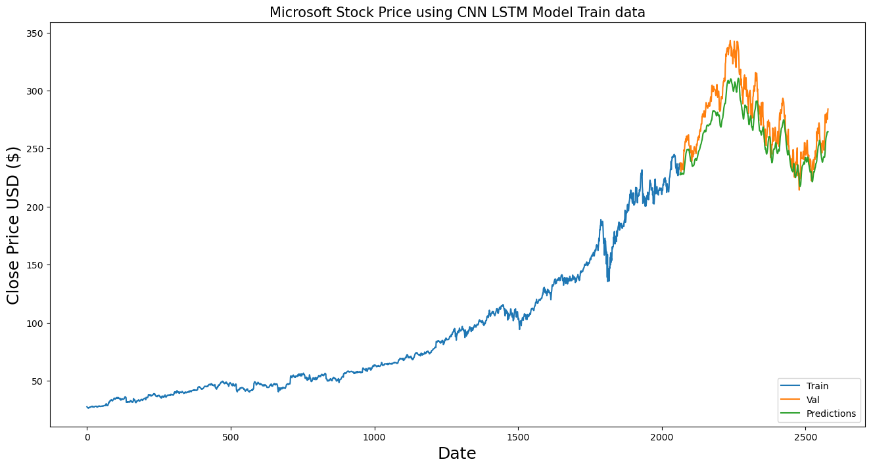
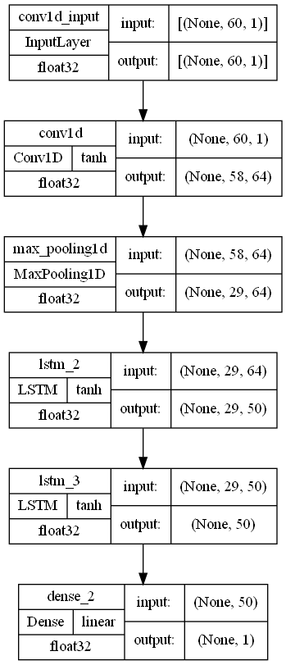
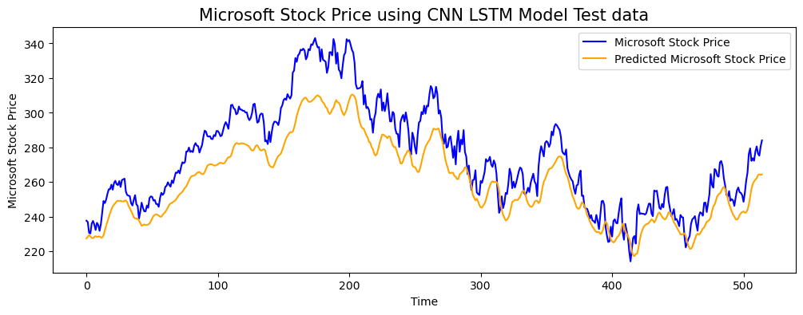
CNN LSTM Model
R^2 = 0.6760

Slide 14
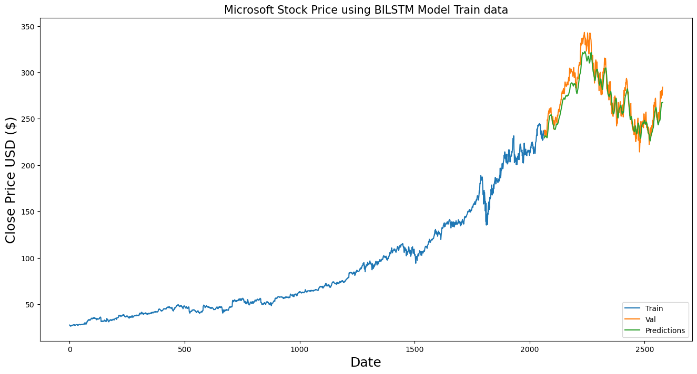
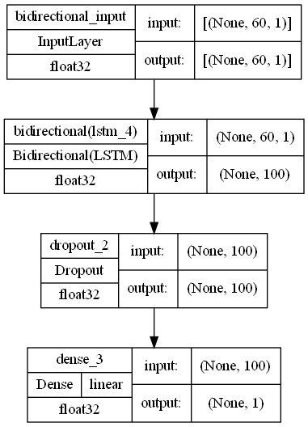
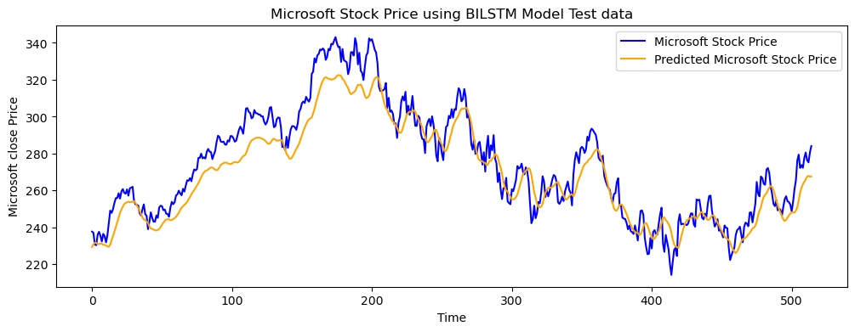
BiLSTM Model
R^2 = 0.8685

Slide 15

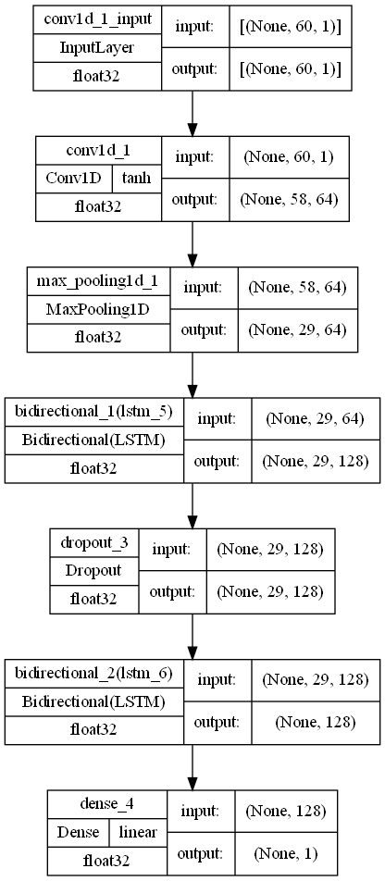
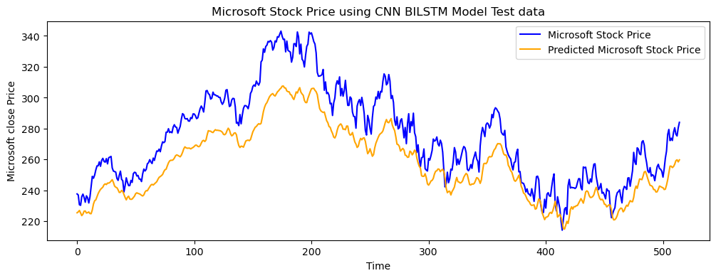
CNN BiLSTM Model
R^2 = 0.5765

Slide 16
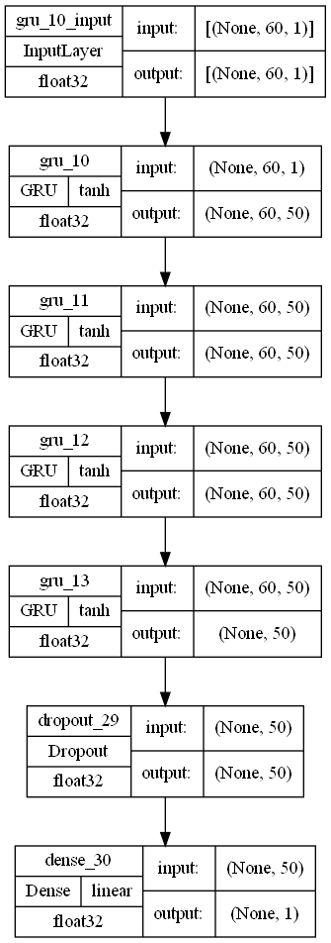
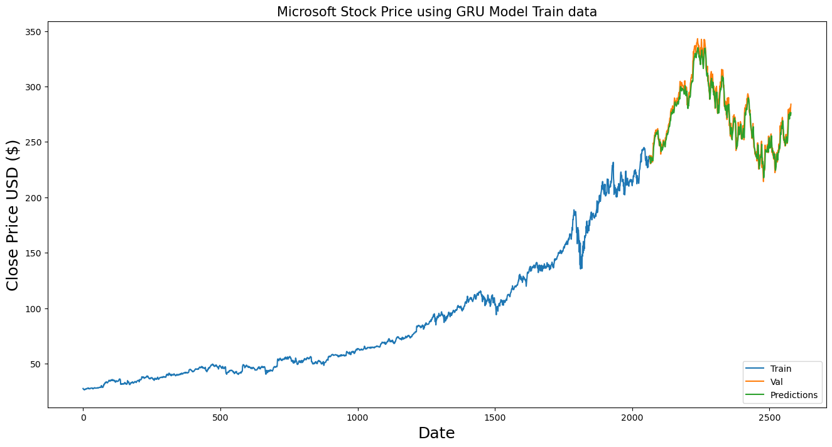

GRU Model
R^2 = 0.9585

Slide 17
Model Comparison
Model | MSE | RMSE | R^2 | MAE | LOSS | Epochs
Neural Prophet | 166.5174 | 12.9041 |  | 8.153888 | 0 | 147
LSTM | 4.1871 | 2.0462 | 0.9233 | 0.006089 | 7.177415682235733e-05 | 50
CNN LSTM | 209.99 | 14.49126 | 0.6760 | 0.00385 | 2.8419215595931746e-05 | 50
BiLSTM | 39.314 | 6.2701 | 0.8685 | 0.004941 | 4.929312490276061e-05 | 50
CNN BiLSTM | 299.113 | 17.2948 | 0.5765 | 0.00371 | 2.6556523152976297e-05 | 50
GRU | 6.02317 | 2.4542 | 0.9585 | 0.00489 | 4.8686317313695326e-05 | 50

Slide 18
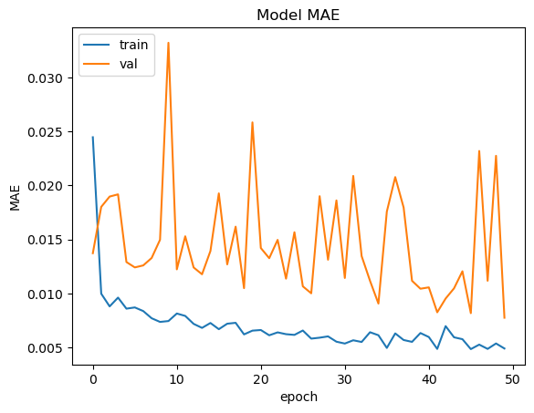
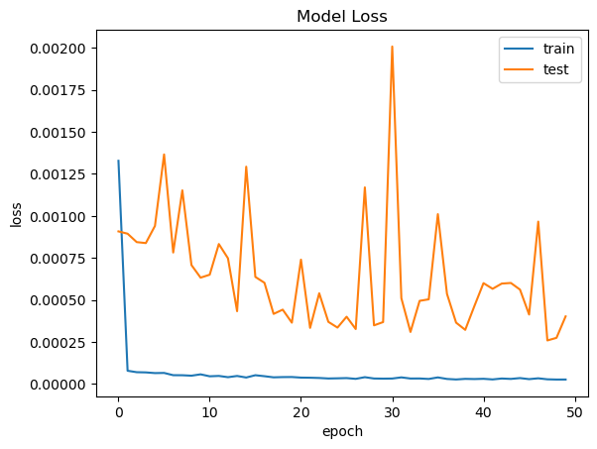
Best Model
Model | MSE | RMSE | R^2 | MAE | LOSS | Epochs
GRU | 6.02317 | 2.4542 | 0.9585 | 0.00489 | 4.8686317313695326e-05 | 50

Slide 19
Reinforcement Learning
Jibi Jacob
Swathy Raja

Slide 20
Mind Tracker

Slide 21

Mind Tracker
Influenced from the famous game “Among Us”.
Multi-Player Game – 1 Psychic(AI Agent) and other players.
Each level takes place in different Environment.
Each player is assigned a set of tasks for each level, where the difficulty level increases.
Each player has unique ability and skillset.
All player must work together and communicate with each other for achieving their objectives

Slide 22

How it works?
How the game ends?
The psychic must achieve an objective by influencing other players through intimidation, persuasion or deception, while the other players must focus on completing their set of task without being influenced by the psychic who is in disguise.
The game will end, if the player completes all their objective OR the psychic attains its objective through other players.

Slide 23




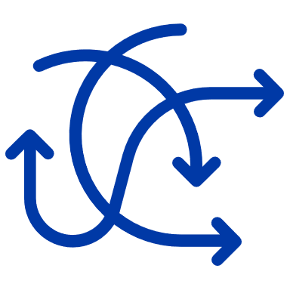

Actions
States
Psychic selects a target player
The objective of the psychic and its progress rate.
Watch and analyze the player and decide on the influencing method
The objective of other players and their corresponding progress rates.
Altering the environment to distract other players
How successfully the psychic was able to influence other players.

Slide 24
Rewards For Psychic
POSITIVE
NEGATIVE
1
If psychic is able to influence other players
If psychics attempt to influence is unsuccessful
1
If psychic is able to successfully complete its objective.
If other players achieve their objective
2
2
3
If psychic is able to influence a player before they completed their first task (Bonus)

Slide 25




Hypothesis for action, reward and state distribution
01
Deep Q-Network
04
Takes input as current state and gives expected reward for each action in that particular state.
Long Short Term Memory
To remember important details about actions and states of the Game
02
Proximal Policy Optimization
Input is the state of the game and output is the probability of taking each possible action in that state
05
03
Attention Mechanism
ReLU
Focus on important details of the state of the game.
Activation function in hidden layers to introduce non-linearity component

Slide 26
Final Reward
Positive Reward
Negative Reward
Final Reward
Maximize the positive rewards by successfully influencing other players
Minimize the negative rewards by lowering unsuccessful influence attempts

Slide 27






Analysis Procedure
Preprocess the data into a format that can be used for Reinforcement Learning Algorithms
Initialize the neural network with random weights
Setting the exploration rate, learning rate, and discount factor
Psychic chooses either the best-known action or explores new action best suited for that state
New state and reward transitions should be updated in PPO and DQN along with updating network weights
A batch of the transitions will be sampled, and network weights will be updated with the goal of minimizing the difference between predicted and actual Q values
The process is repeated until the psychic attains a satisfactory performance

Slide 28

Questions?

Slide 29
Thank You

